Slide 1
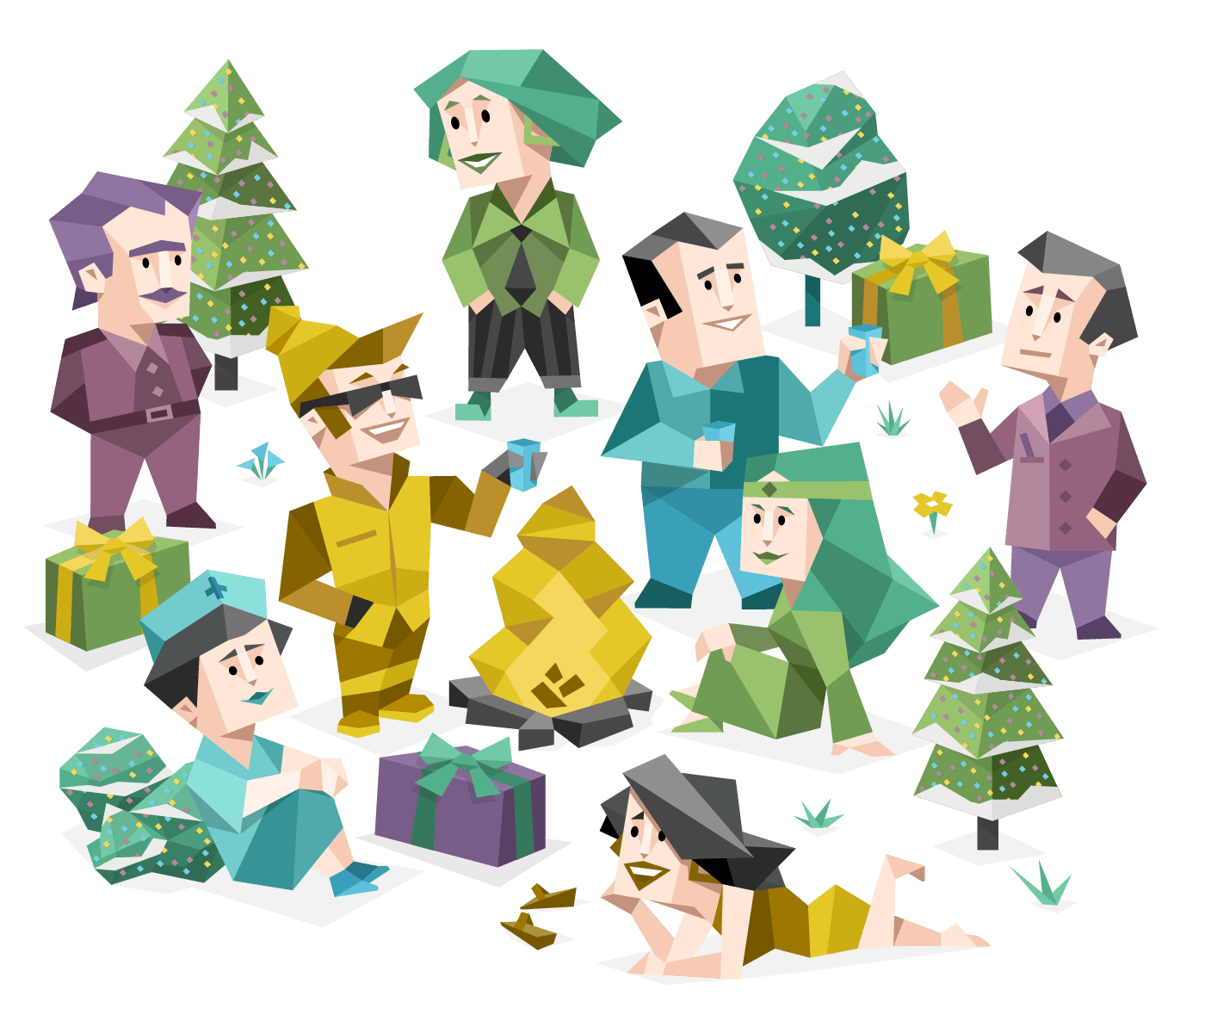
Myers-Briggs Personality
Type Identifier
Sakshi Joshi
Irene Kim
Luc Siano

Slide 2
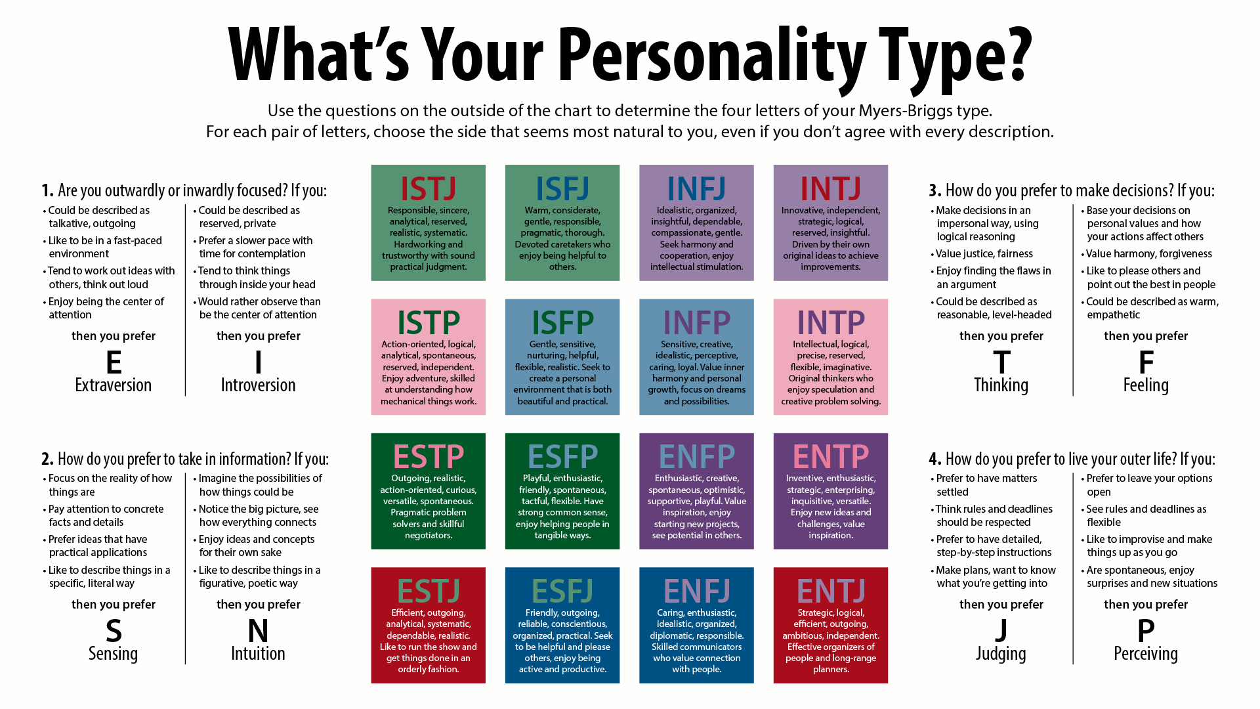
What is MBTI?
Introspective quiz
Result indicates how people perceive the world and make decisions
Categories
Introversion (I) vs Extraversion (E)
Sensing (S) vs Intuition (N)
Thinking (T) vs Feeling (F)
Judging (J) vs Perceiving (P)
Four-letter test result: i.e. INFJ

Slide 3
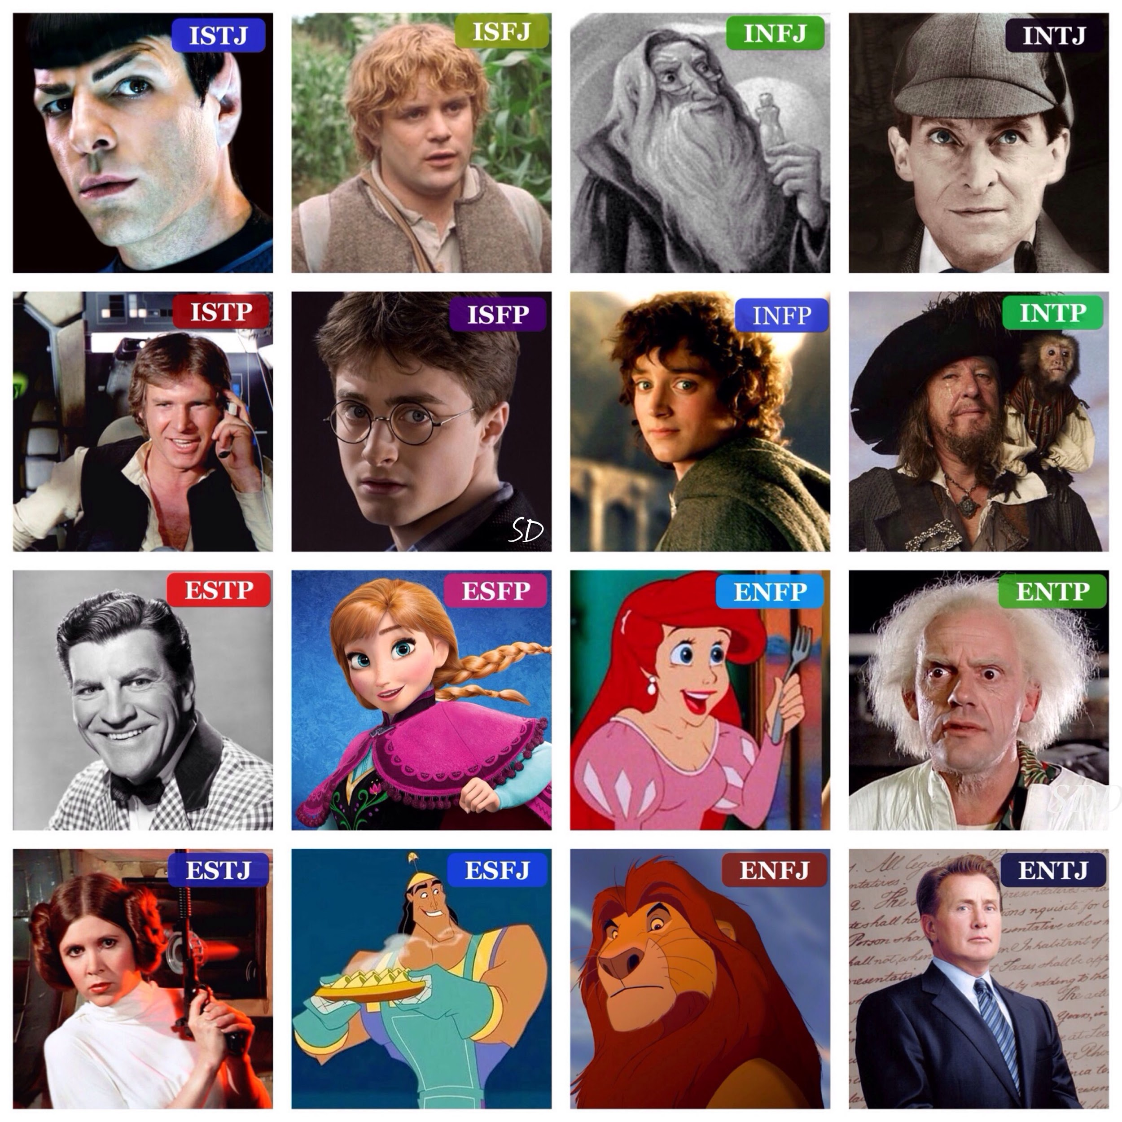
Real World Application
Personality test used by:
Mental health professionals
Organizational settings
Educational settings
Most common type: ISFJ ~14%
Most rare type: INFJ ~1-3%

Slide 4
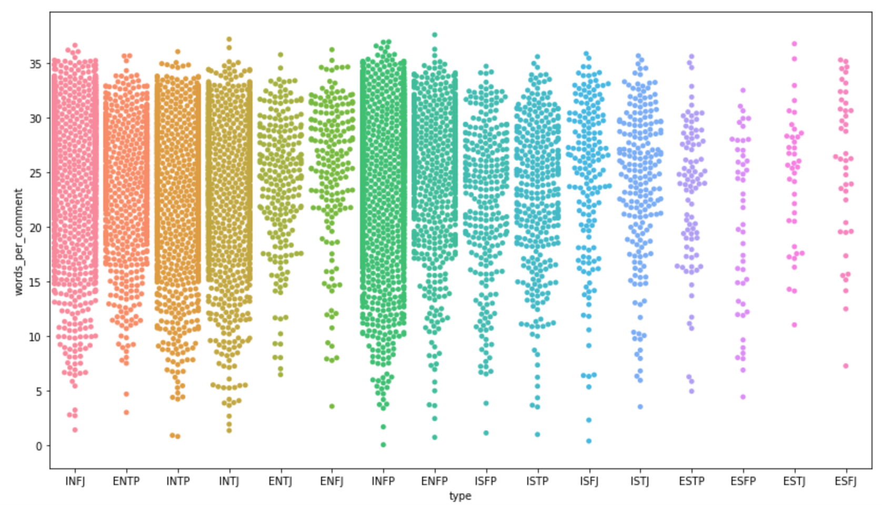
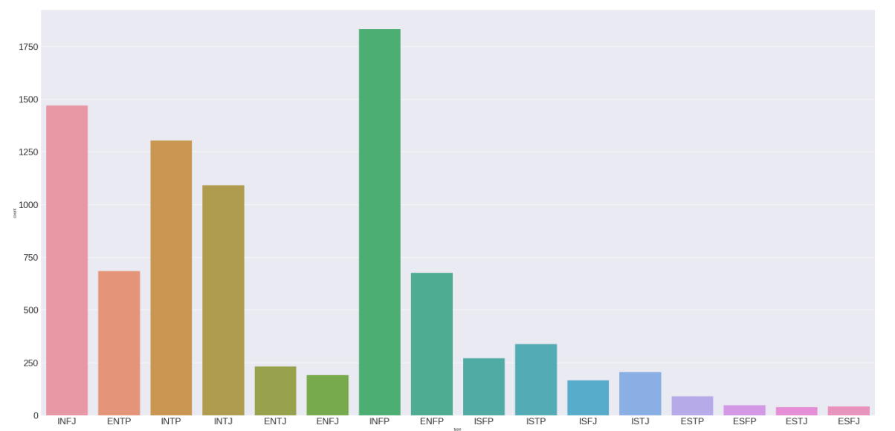
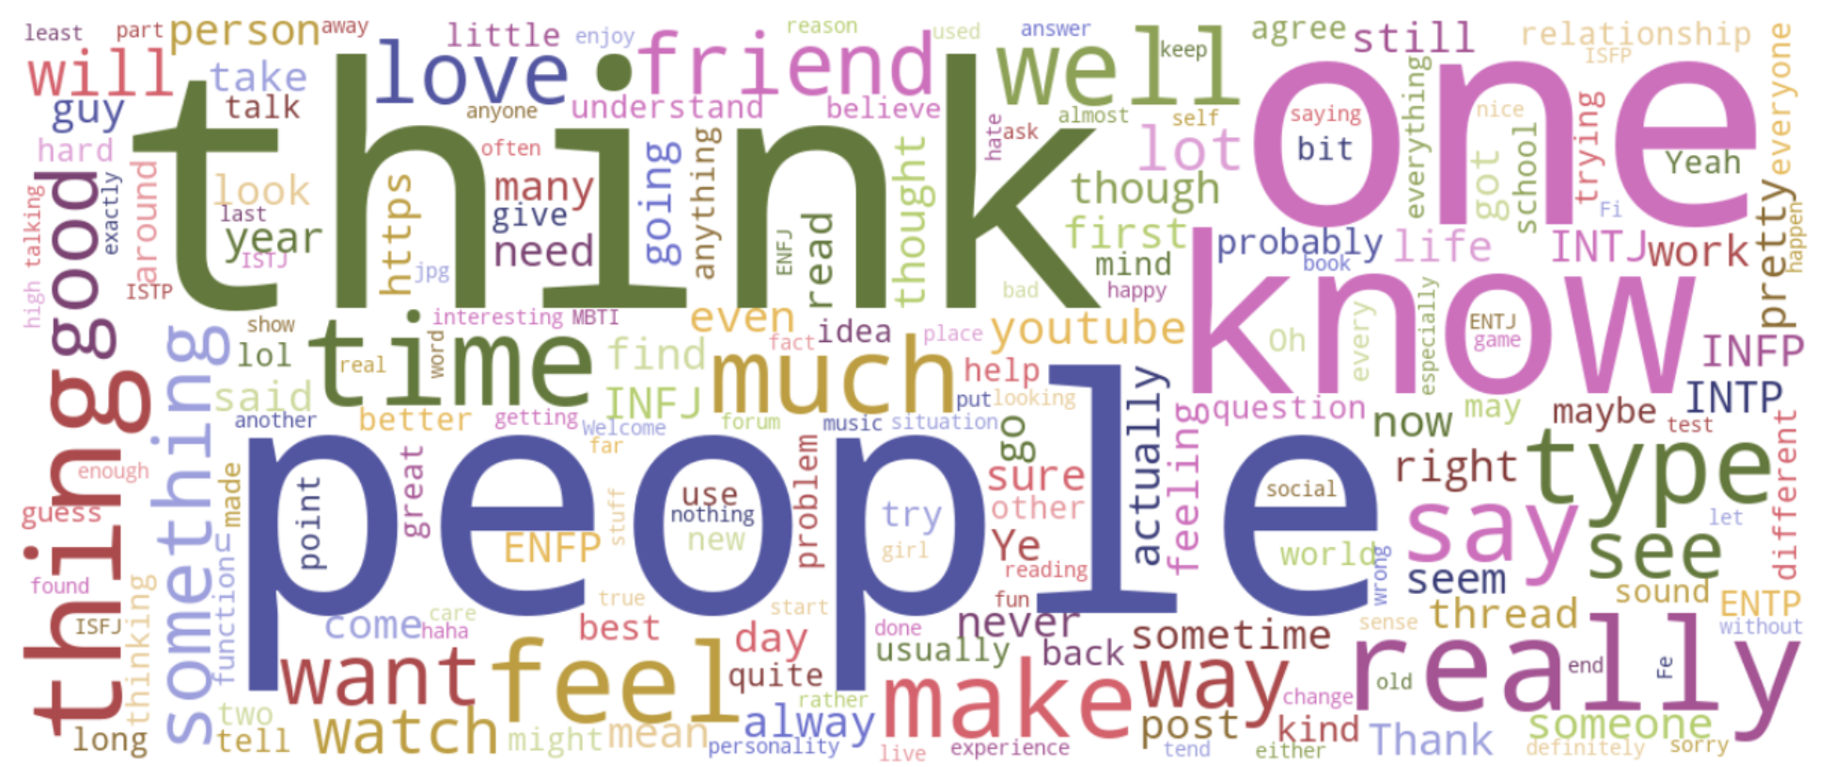
EDA
Text here
Notes:
Bottom pic is all words no specific groups
Top left pic is word count by each type
Top right is just count of each type
Based on the top two pictures data seems more skewed to Introvert type based off the right graph and whilst the graph on the left backs that up it also shows a good idea as to why our models probably had a hard time guessing other types outside of the top 6 types (INFP,INTJ,INTP,ENTP,INFJ,ENFP)

Slide 5
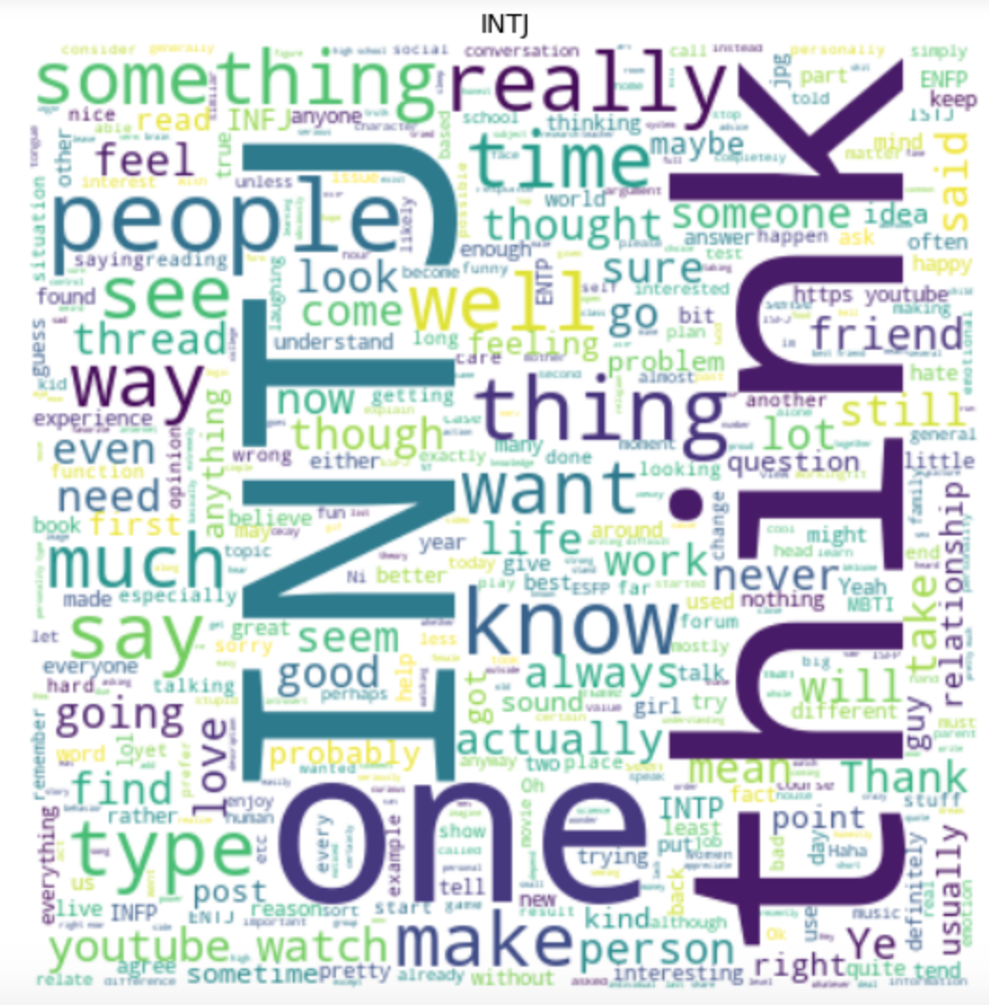
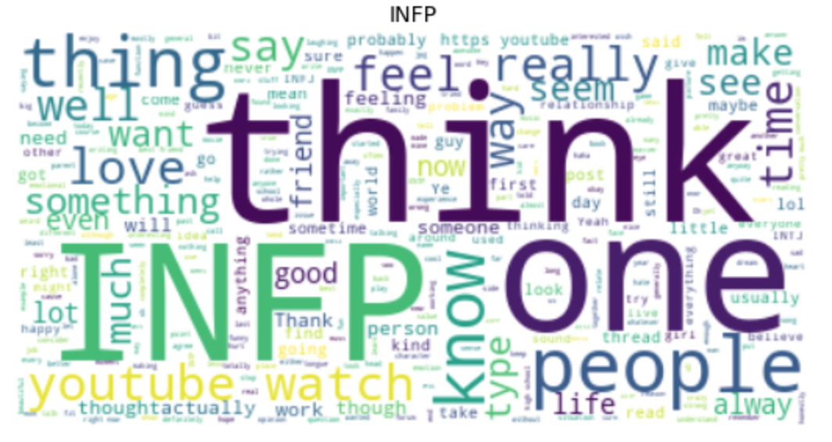
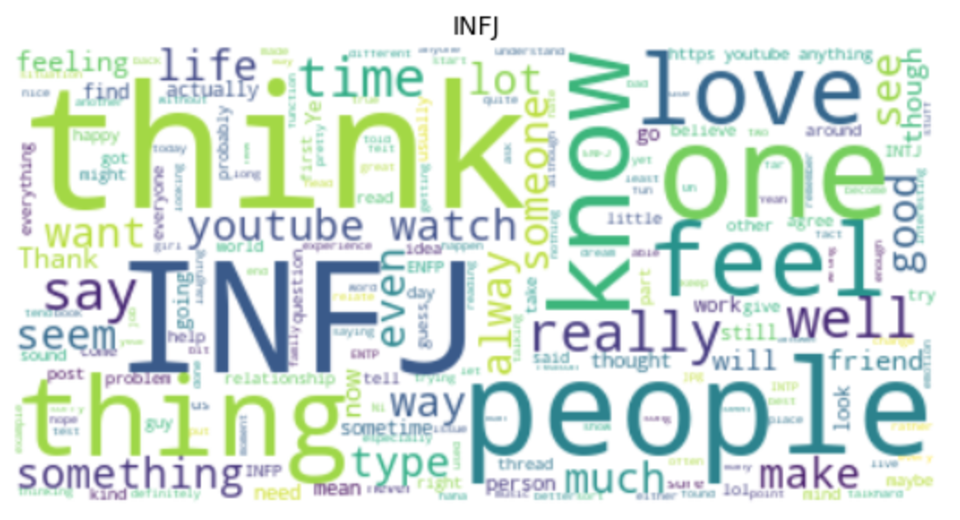
EDA
Notes:
You dont have to use these three images but its just another view of of the top words for a few respected groups if you want me to pull any other particular group let me know but i guess the take away from these is (my brain is fried so if this doesnt make sense just ask and ill try to reiterate) there arent many common words to really distinguish the other groups from each other super heavily so it partly makes sense that people who are “IN--” might use a similar vocabulary with few words to distinguish from each other this is kind of apparent in the testing of the movie quotes.

Slide 6
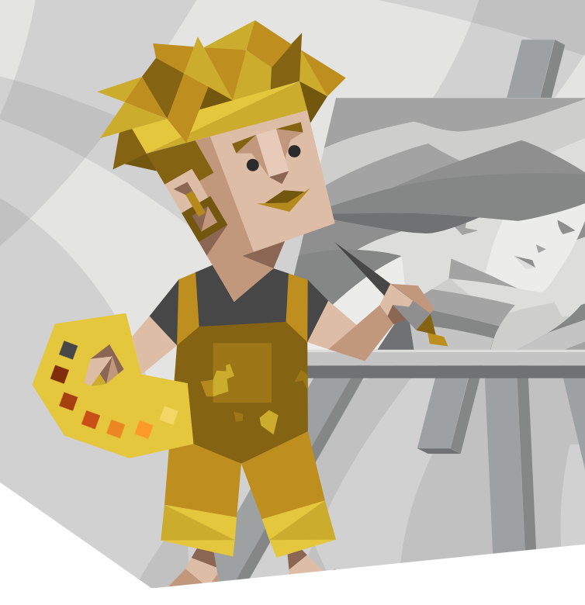
Methodology
Initial data preprocessing
Vectorized initial data
Split data into 75% train & 25 % testing with an additional validation set.
Models
K-Nearest Neighbors
Random Forest
SVM
Logistic Regression
Notes:
Tried a variety of models starting with Random forest, then Naive bayes, then KNN,
The TFIDFVectorizer will tokenize the documents, learn the vocabulary and "inverse document frequency weights",

Slide 7
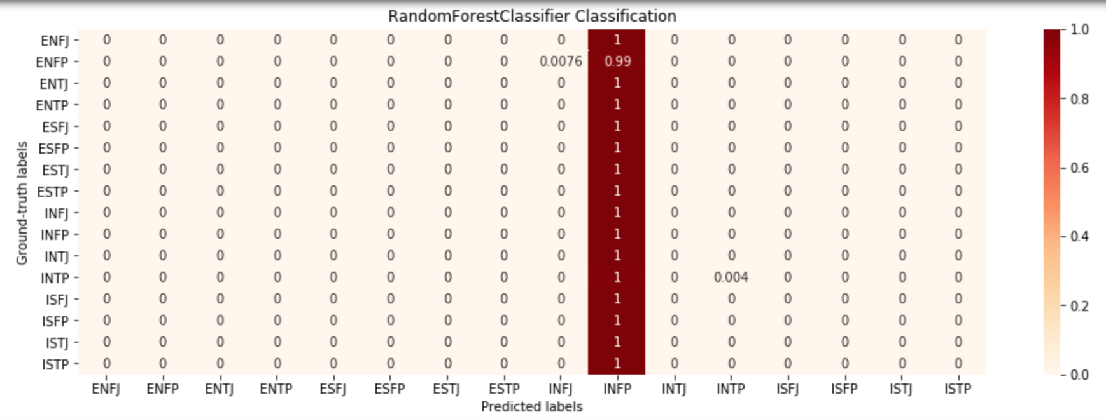
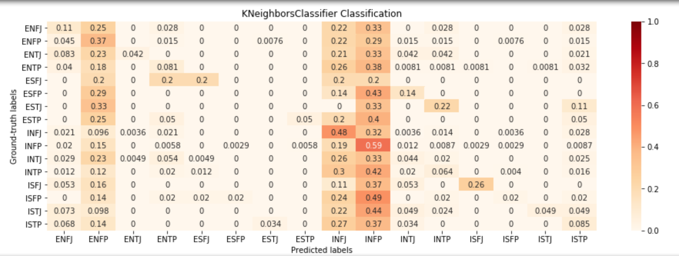
Models (KNN & Random Forest)
Notes:
My first initial test of using a Random forest model proved to be very ineffective with a very low accuracy
Using a KNN model showed more promising results but still performing very poorly in the grand scheme of it all bringing in a 27% accuracy

Slide 8
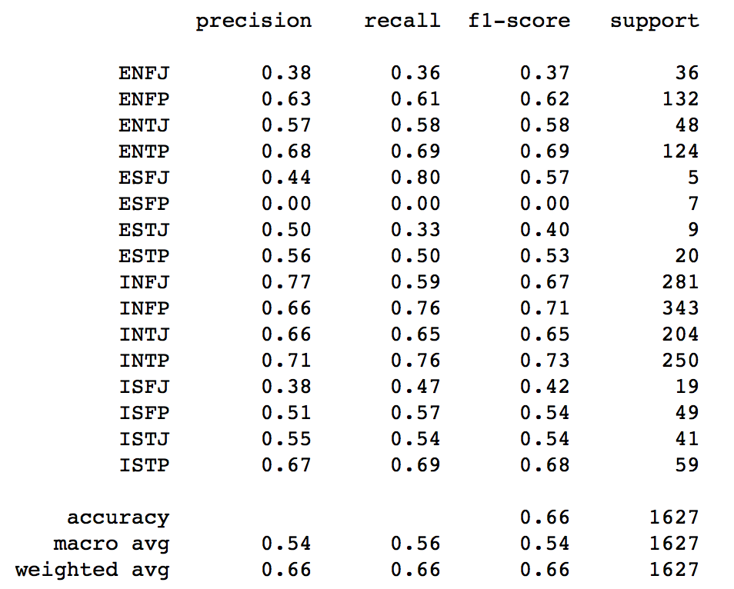
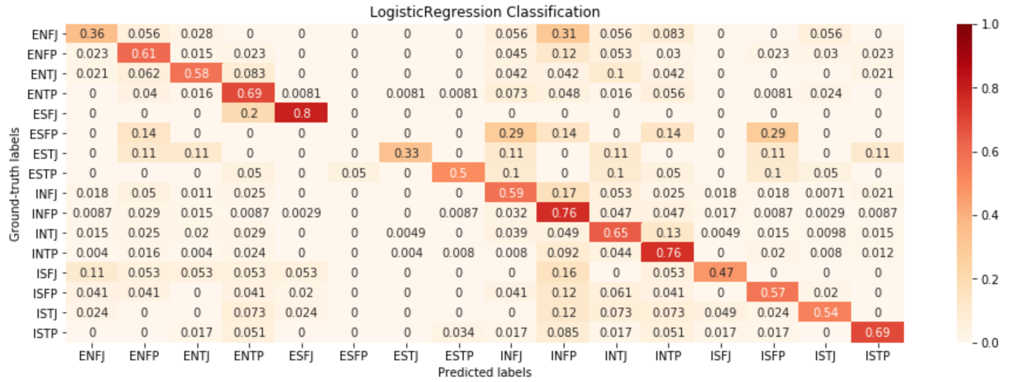
Models (Logistic Regression)

Slide 9
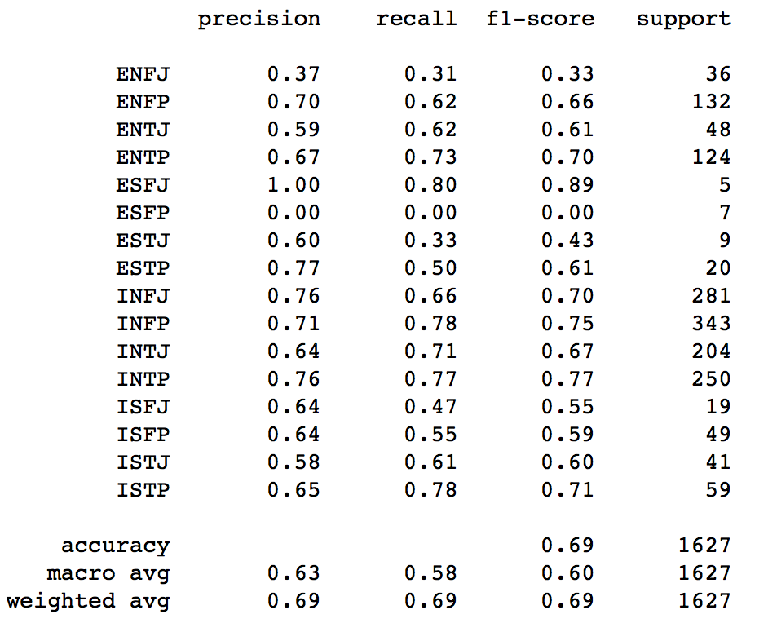
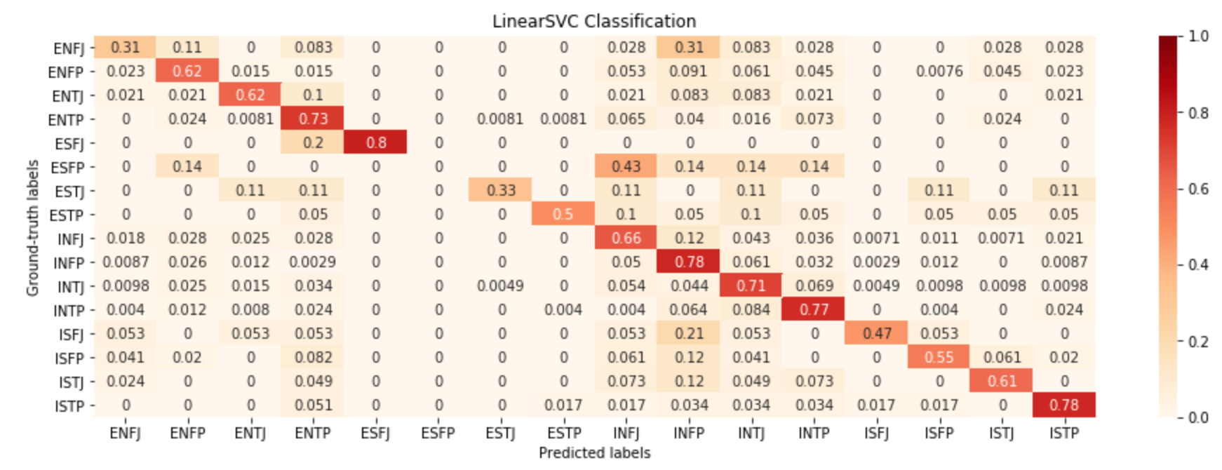
Models (SVM)

Slide 10
Model Recap
01
Random Forest
No Tangible results
20% accuracy
02
KNN
More predictive power but still very weak
27% accuracy
03
Logistic Regression
Good predictive power
66% accuracy
04
SVM
Slightly better than Logistic Regression
69% accuracy
Notes:
Recap all my models then go into challenges that i faced

Slide 11
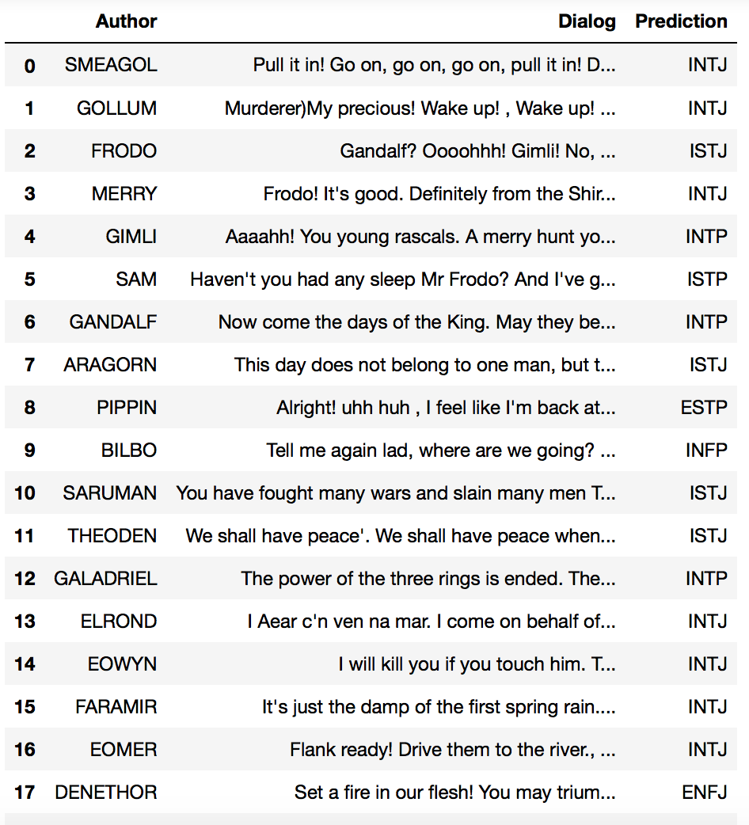
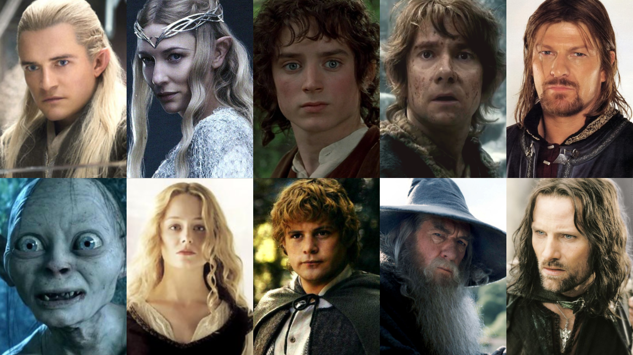
Testing on other sources
Model struggled
Hard to get characters true personality
Notes:
27 main characters, across the 3 movies tried to classify a personality based on their quotes from the movies, so first the dataset had some irrelevant characters that we had to remove to get the 27 then we decided to group all the quotes into one instead of per movie to avoid different personality types discrepancy
Issues came in checking the if the personality guessed was correct, more of a subjective matter but we ended up using an article that gave what their type was, my model in particular didnt do so great it only guessed 1 personality type correctly and others it would be off by a single trait or entirely
This could be due to the nature of the quotes being foreign to the model and not knowing how to handle these new words
Might add my attempts of classifying characters in the lotr dataset but beside a dataframe to show the prediction i dont have any like accuracy metrics beside that one article but i can talk about the short comings of testing the whole dataset here or in the challenges section

Slide 12
Challenges
Text here
Luc - When doing initial text mining/EDA many of the personality types blended together or there seemed to be few distinguishing features
Sakshi - talk about your struggles
What you have learned from the real data analysis: data cleansing, missing data, data
transformations, like normalization, taking log and adding square terms (Discussion)
Notes:
Recap of both models
Struggles for both methods
Different approaches we could’ve taken
Different datasets to test models (lotr and speeches)

Slide 13
Methodology (Neural Networks)
Initial data preprocessing
Cleaning data
Tokenize the data into fixed length
Models
RNN
Transformer (2017)
BERT (2018)

Slide 14
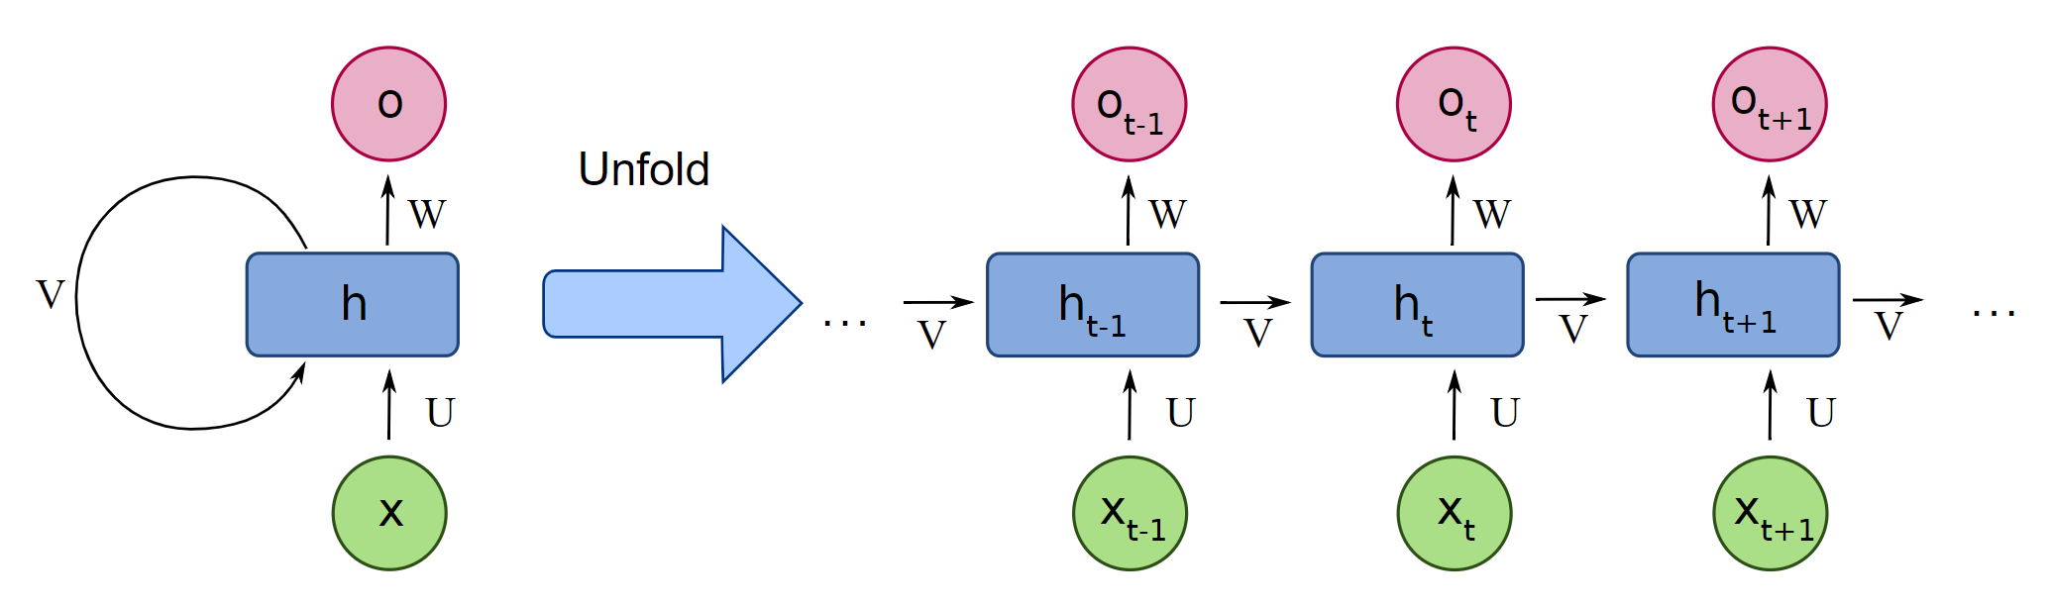
Models (RNN)
Sequential input
Forward & Backward propagation

Slide 15
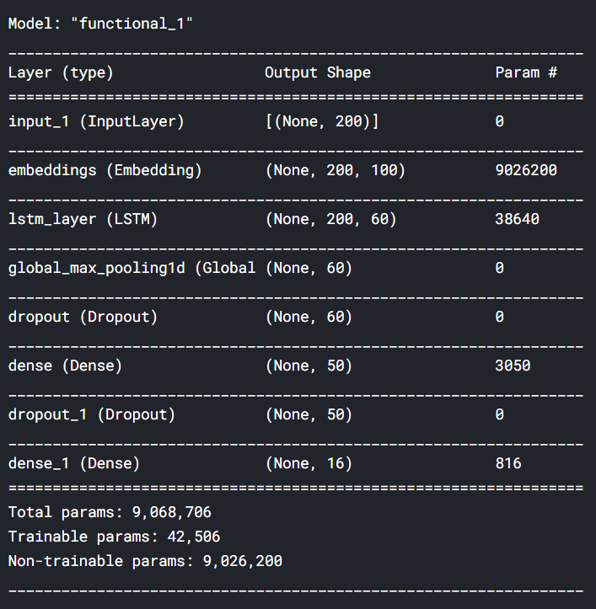
Models (RNN)
Max sequence length = 200
Word2Vec Embedding
LSTM
Model parameters:
Activation - ReLu
Optimizer - Softmax
Loss - categorical_crossentropy

Slide 16
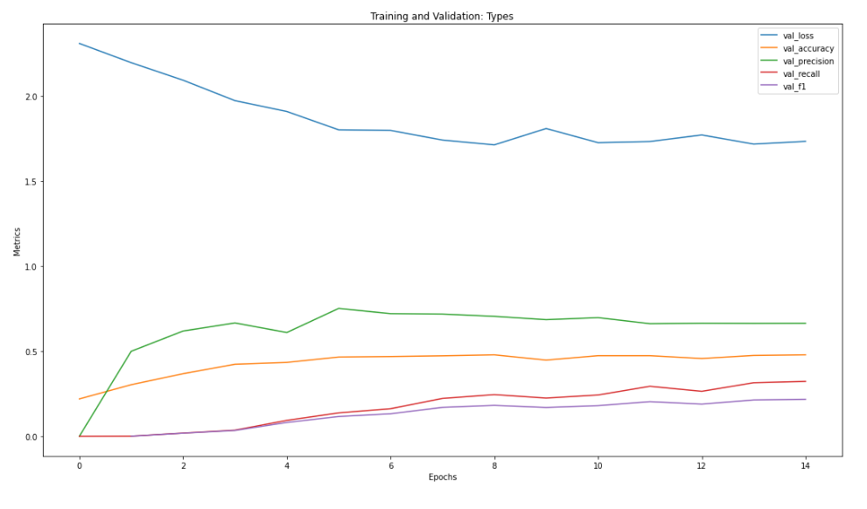
Models (RNN)
Accuracy ~ 50%

Slide 17

Models (Transformer)
Seq2Seq modeling
Encoder & Decoder
Inputs - Entire text
Attention Matrix
Outputs - single words shifted right
Output Probability - Probability vector for the next word
Accuracy ~ 60%

Slide 18
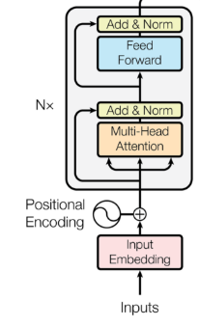
Models (BERT)
Bidirectional Encoder Representations from Transformers
Stacked Encoder
Pretrained model -
What is Language? (Masked LM)
What is Context? (NSP)
Fine tune BERT for application

Slide 19
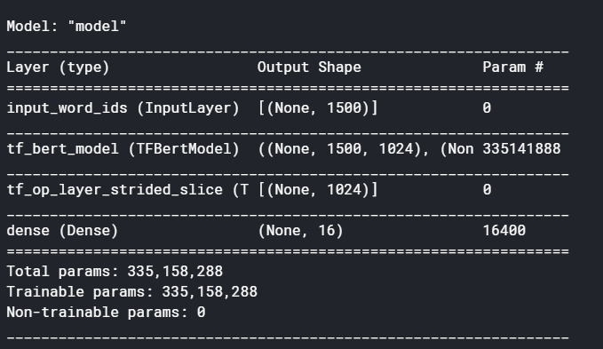
Models (BERT)
Max sequence length = 1500
Pre-train BERT (24 stacked)
Dense Layer
Model parameters:
Activation - Softmax
Loss - categorical_
crossentropy

Slide 20
Application
Test Case - Classify Lord of the Rings characters based on their Myers-Briggs personality type
Data - Lord of the Rings script for “The Fellowship of the Ring”, “The Return of the King” and “The Two Towers”

Slide 21
Application
Author | Article | Prediction
FRODO | INFP | INFP
ELROND | ENTJ | ENTJ
SARUMAN | INTJ | INTJ
LEGOLAS | ENFP | INFP
GALADRIEL | INFJ | INFP
GANDALF | INTP | INTJ
PIPPIN | ESFP | ESFJ
SAM | ESTJ | ESFJ
ARAGORN | ISTP | ISTJ
BOROMIR | ESFJ | EIFJ
ARWEN | ENFJ | ENTP
MERRY | ISFJ | ISTP
GIMLI | ESTP | INFP
Test Case - Classify Lord of the Rings characters based on their Myers-Briggs personality type

Slide 22
Future Scope
A dataset with wide variety of data
Train better models for rare personality labels (balanced dataset)
Validate personalities of real people (social media)
Find commonalities between people and their following
I.e. If the majority of Oprah’s fans are IN _ _
Notes:
Youtube links

Slide 23
Thank You!

